Slide 1
Lecture Voice to Notes Generator
CAPSTONE PROJECT
Presented By:
Lingesh R
Hindusthan College of Engineering and Technology
BE Computer Science and Engineering

Slide 2
OUTLINE
Problem Statement
System Development Approach
Algorithm & Deployment
Result
Conclusion
Future Scope
References

Slide 3
Problem Statement
In academic settings, students often face challenges in effectively capturing information during lectures, seminars, or discussions. The need to actively listen, comprehend, and take notes simultaneously leads to missed key points and incomplete understanding. Manual note-taking is time-consuming and prone to errors, especially when lectures involve complex or fast-paced content.
Problem: There is a growing need for an intelligent, accessible system that can automatically convert spoken lectures into accurate written transcripts and generate concise, well-structured study materials—such as notes, quizzes, and flashcards. Such a system would leverage speech-to-text and generative AI technologies to enhance learning efficiency, improve retention, and reduce students’ cognitive load during lectures.

Slide 4
System Approach
Frontend | Streamlit web application for user interaction — enables audio upload, language selection, and display of generated outputs (notes, quizzes, flashcards) in an intuitive, responsive interface.
Backend | Python-based logic layer (backend_core.py) that manages audio file handling, session state, and interaction between the transcription and generative AI modules. It also handles PDF/text file generation and user feedback storage.
Model Engine | Google Gemini API serves as the core AI engine for both speech-to-text transcription and content generation (notes summarization, quiz, and flashcard creation). The model processes audio and text inputs to produce accurate, context-aware study material in the user’s chosen language (multi-language).
Data Handling | Temporary audio files are securely stored for processing; generated content and session history are saved in local JSON files. Feedback data is logged for quality improvement.
Output | Users receive transcribed, summarized, and translated lecture content that can be downloaded as PDF or TXT files.

Slide 5
Algorithm & Deployment
1. Privacy & Security
Temporary audio processing; files deleted post-transcription.
No personally identifiable information (PII) stored or shared.
HTTPS-secured communication with Gemini API.
2. Availability
Cloud-deployable for 24/7 access and Minimal downtime during updates or maintenance.
Students can access anytime for notes or quizzes.
3. Performance
Fast transcription and text generation via Gemini API and low latency on typical audio
Lightweight backend for low-resource environments and efficient for limited networks.
4. Usability
Simple Streamlit interface with upload/output sections.
Options for Notes, Quiz, Flashcards, and language selection.
PDF/text download, responsive on all devices.
5. Scalability
Modular architecture for easy upgrades and ready for features like real-time transcription or multilingual notes.
Supports growing user traffic via API-based processing.

Slide 6
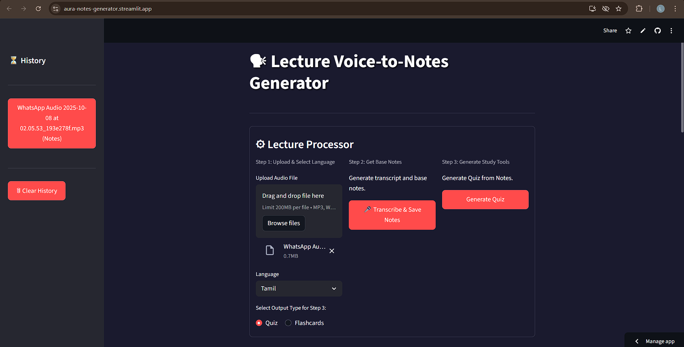
Result 1

Slide 7
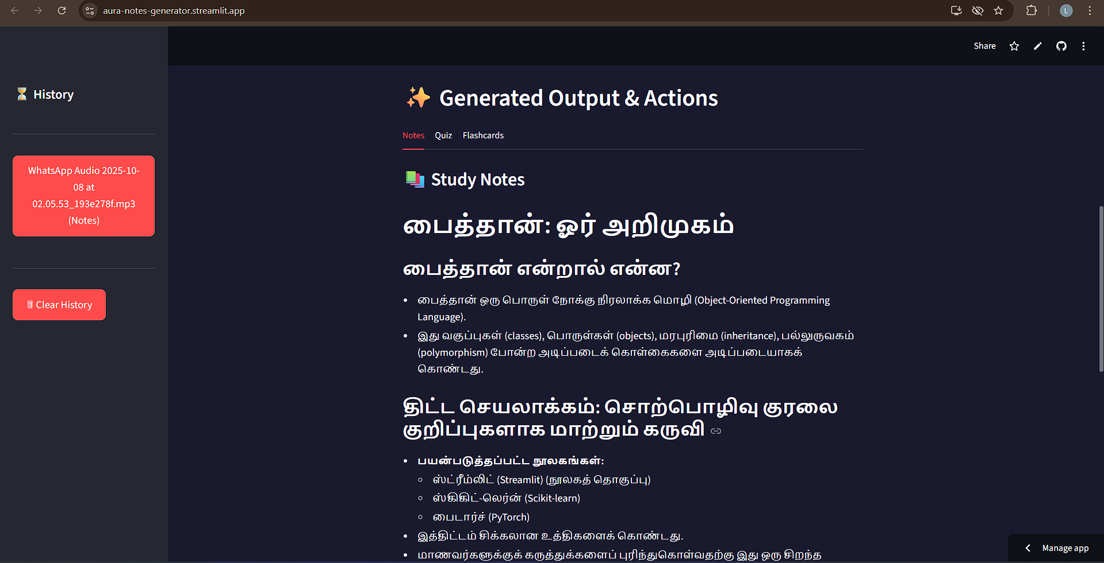
Result 2

Slide 8
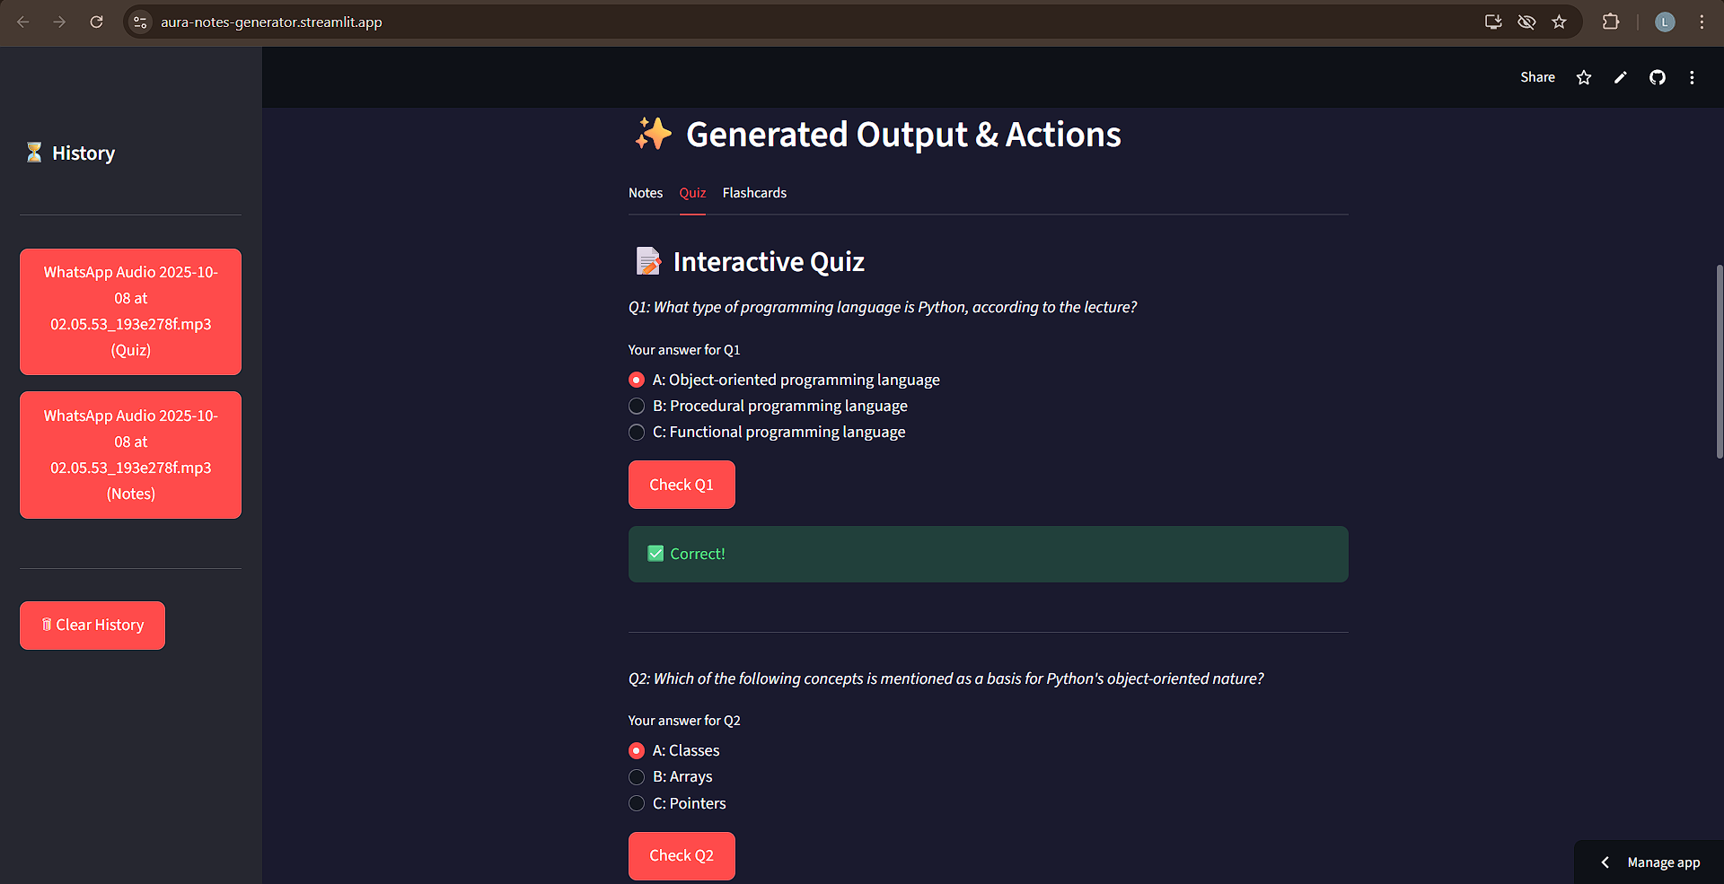
Result 3

Slide 9
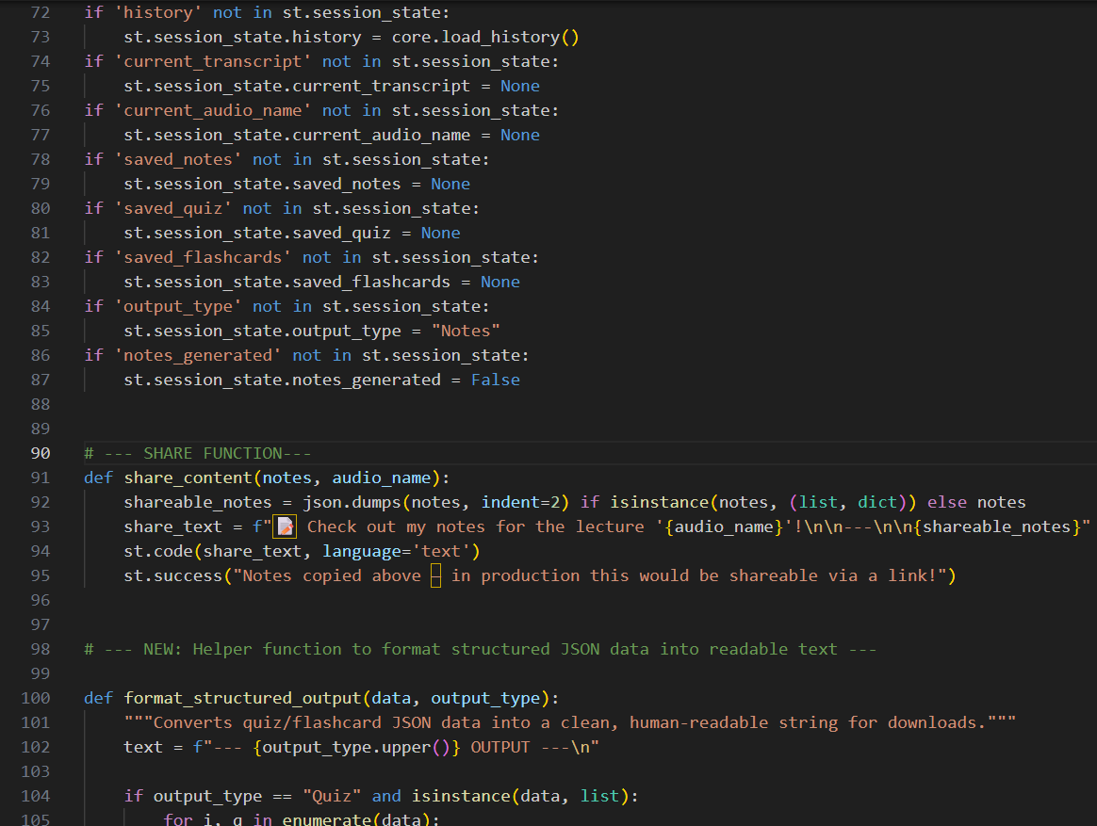
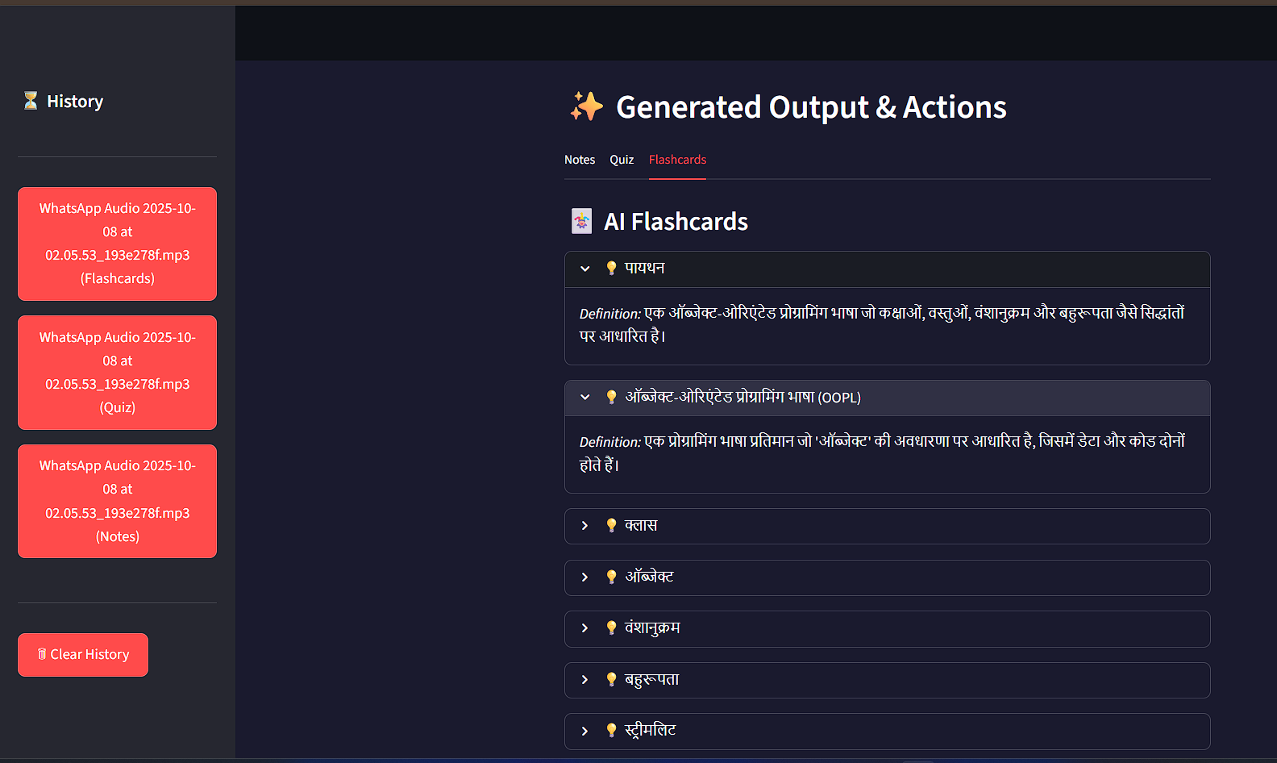
Result 4

Slide 10
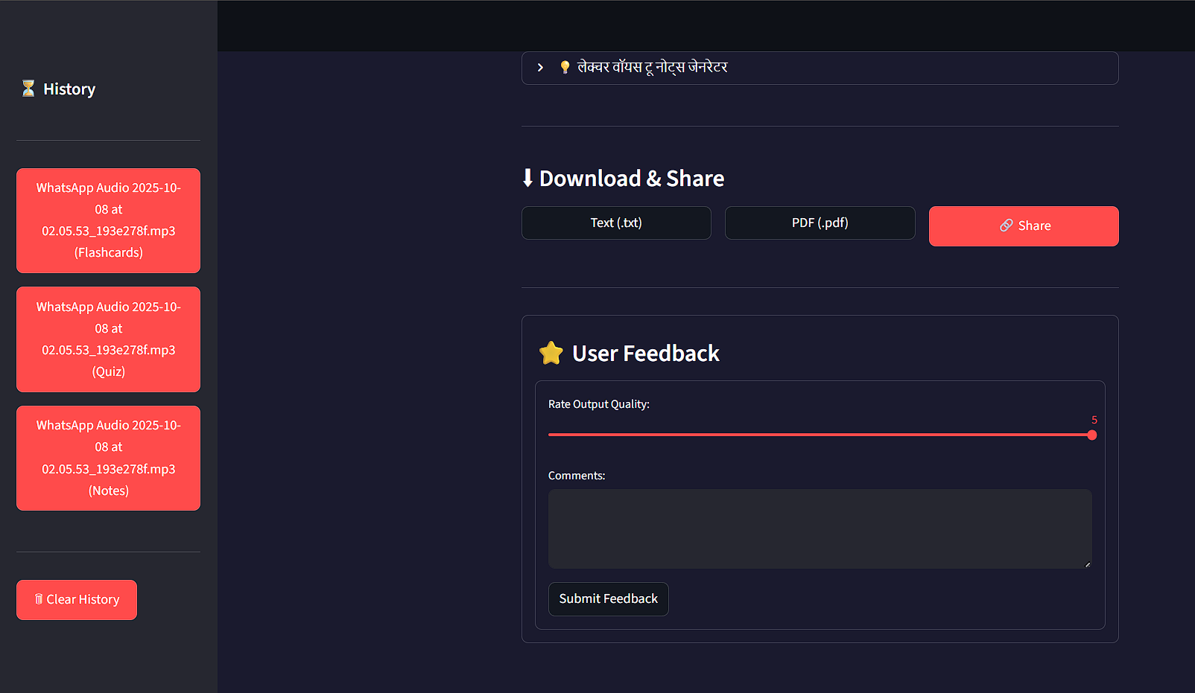
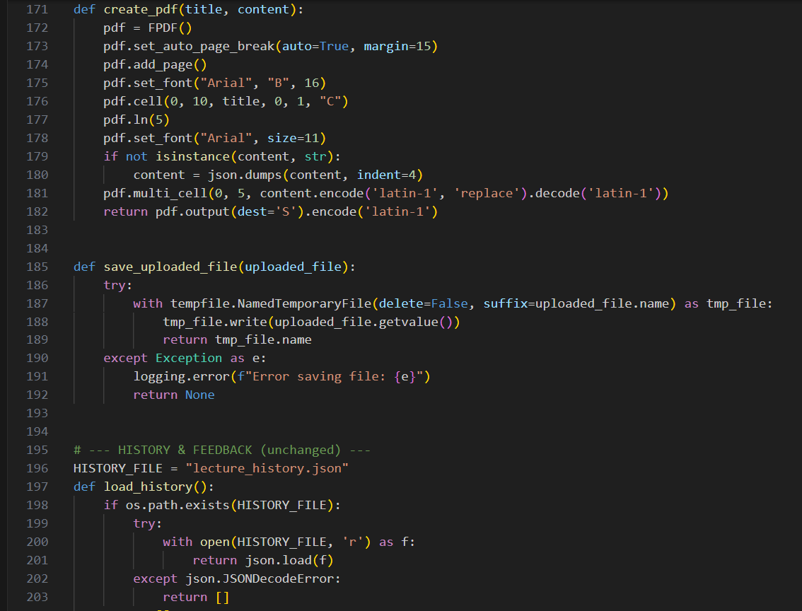
Result 5

Slide 11
GITHUB AND DEPLOYMNET LINK
Github Link :
https://github.com/lingesh1174/AI-Cloud_AICTE_Lingesh_R
Deployment link:
https://aura-notes-generator.streamlit.app/

Slide 12
Conclusion
The development of the Lecture Voice to Notes Generator efficiently converts recorded lectures into concise notes, quizzes, and flashcards. It supports multiple languages and allows downloading content as PDF or text files for offline study. With fast, accurate AI transcription, privacy protection, and an easy-to-use interface, it enhances learning accessibility. Its scalable, cloud-ready design makes it a practical solution for modern education.

Slide 13
Future scopE
Offline Feature : Enable transcription and note generation without internet connectivity.
More Learning Tools : Integrate interactive flashcards, quizzes, and mind maps.
Real-time Lecture Transcription : Convert lectures to notes as they are being delivered.
Expanded Language Support : Add more languages for global accessibility.
AI-Powered Summarization : Provide topic-wise summaries and key insights automatically.
Mobile & Voice Integration : Allow voice commands and mobile app access for convenience.

Slide 14
References
Streamlit Documentation – Build Interactive Data Apps. https://docs.streamlit.io
Gemini API Documentation – Generative AI. https://cloud.google.com/vertex-ai/generative-ai/docs/model-reference/inference
Python Software Foundation. Python Documentation. https://www.python.org/doc/
FPDF Documentation. Creating PDF Reports in Python. https://pyfpdf.github.io/fpdf2/
Kelleher, J., Mac Carthy, M., & Korvir, N. (2022). AI for Education: Speech-to-Text Applications. Springer.

Slide 15
THANK YOU

